Slide 1
Welcome to this Bloom webinar. November 27 2024
With Dr Lisa Thorne, Ness Little and Tracy Bowers
Notes:
All introduce ourselves

Slide 2
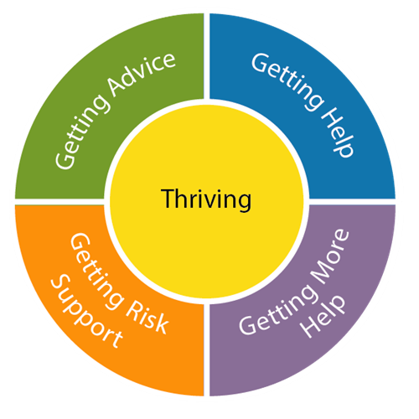
WHAT IS BLOOM? An early intervention multi-agency consultation space that promotes the positive social, emotional, mental health and wellbeing of children and young people.
Notes:
Lisa

Slide 3
Key aims: help to build resilience and empower children, young people (and the adults in their lives) to get the help they need, when they need it. support in the early identification and actioning of support to address emerging signs and symptoms of emotional/mental distress. provide a rapid response for children and young people aged 5 -18 find ways to support the network already in place around the child/young person. support professionals and the wider systems around the family, by offering a formulation, and building understanding as part of the consultation process
Notes:
Lisa

Slide 4
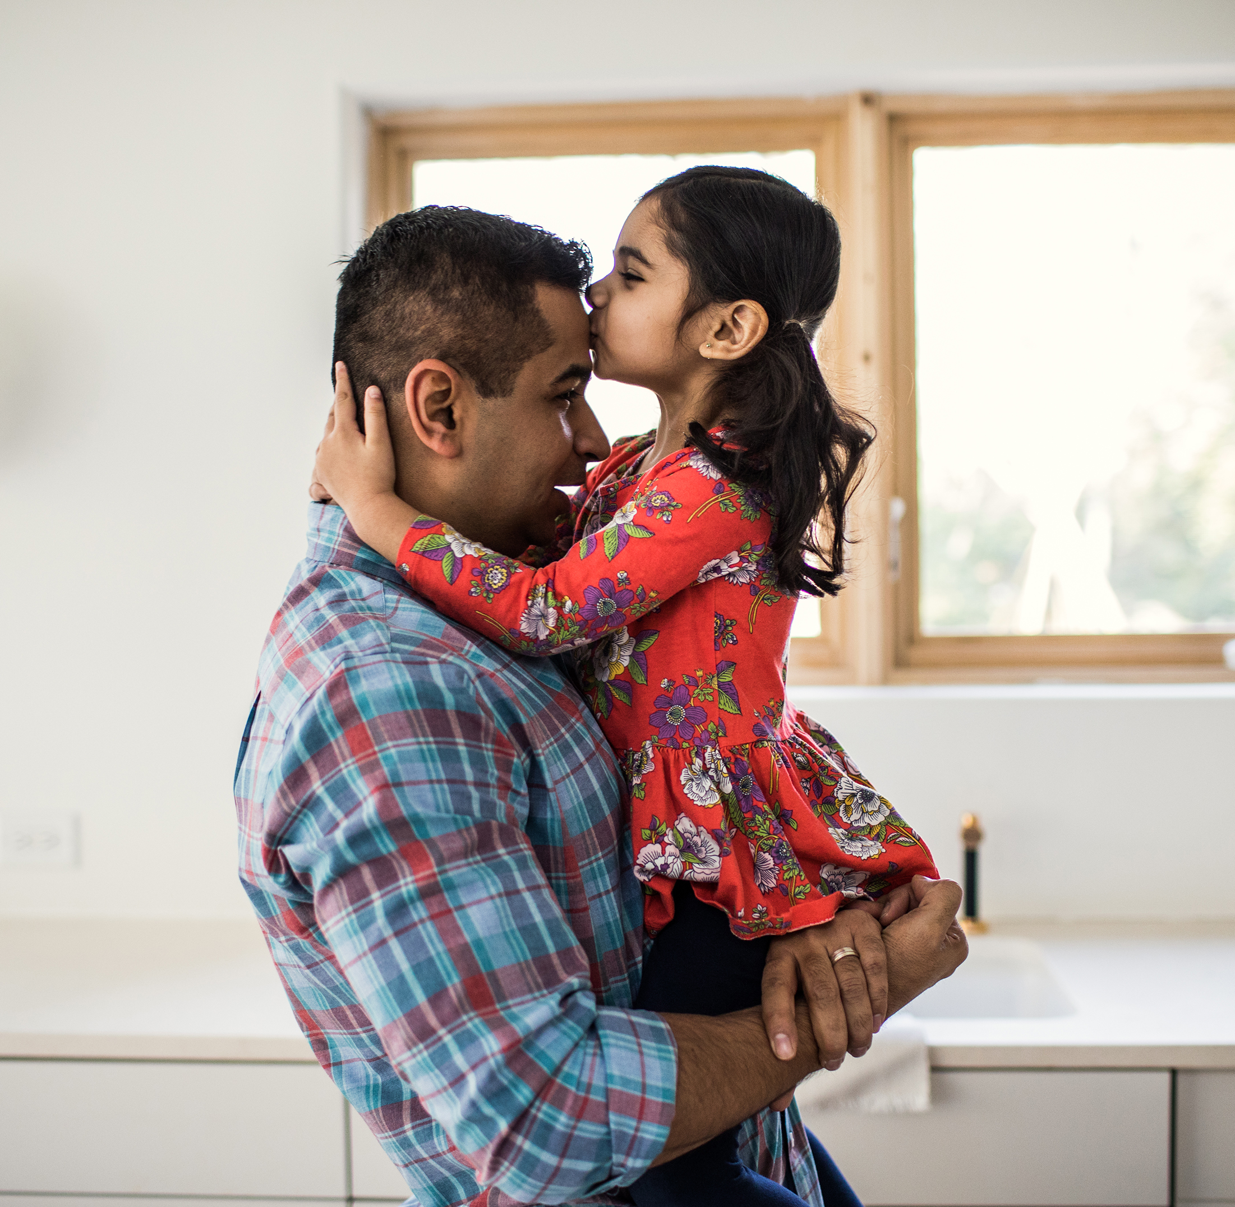
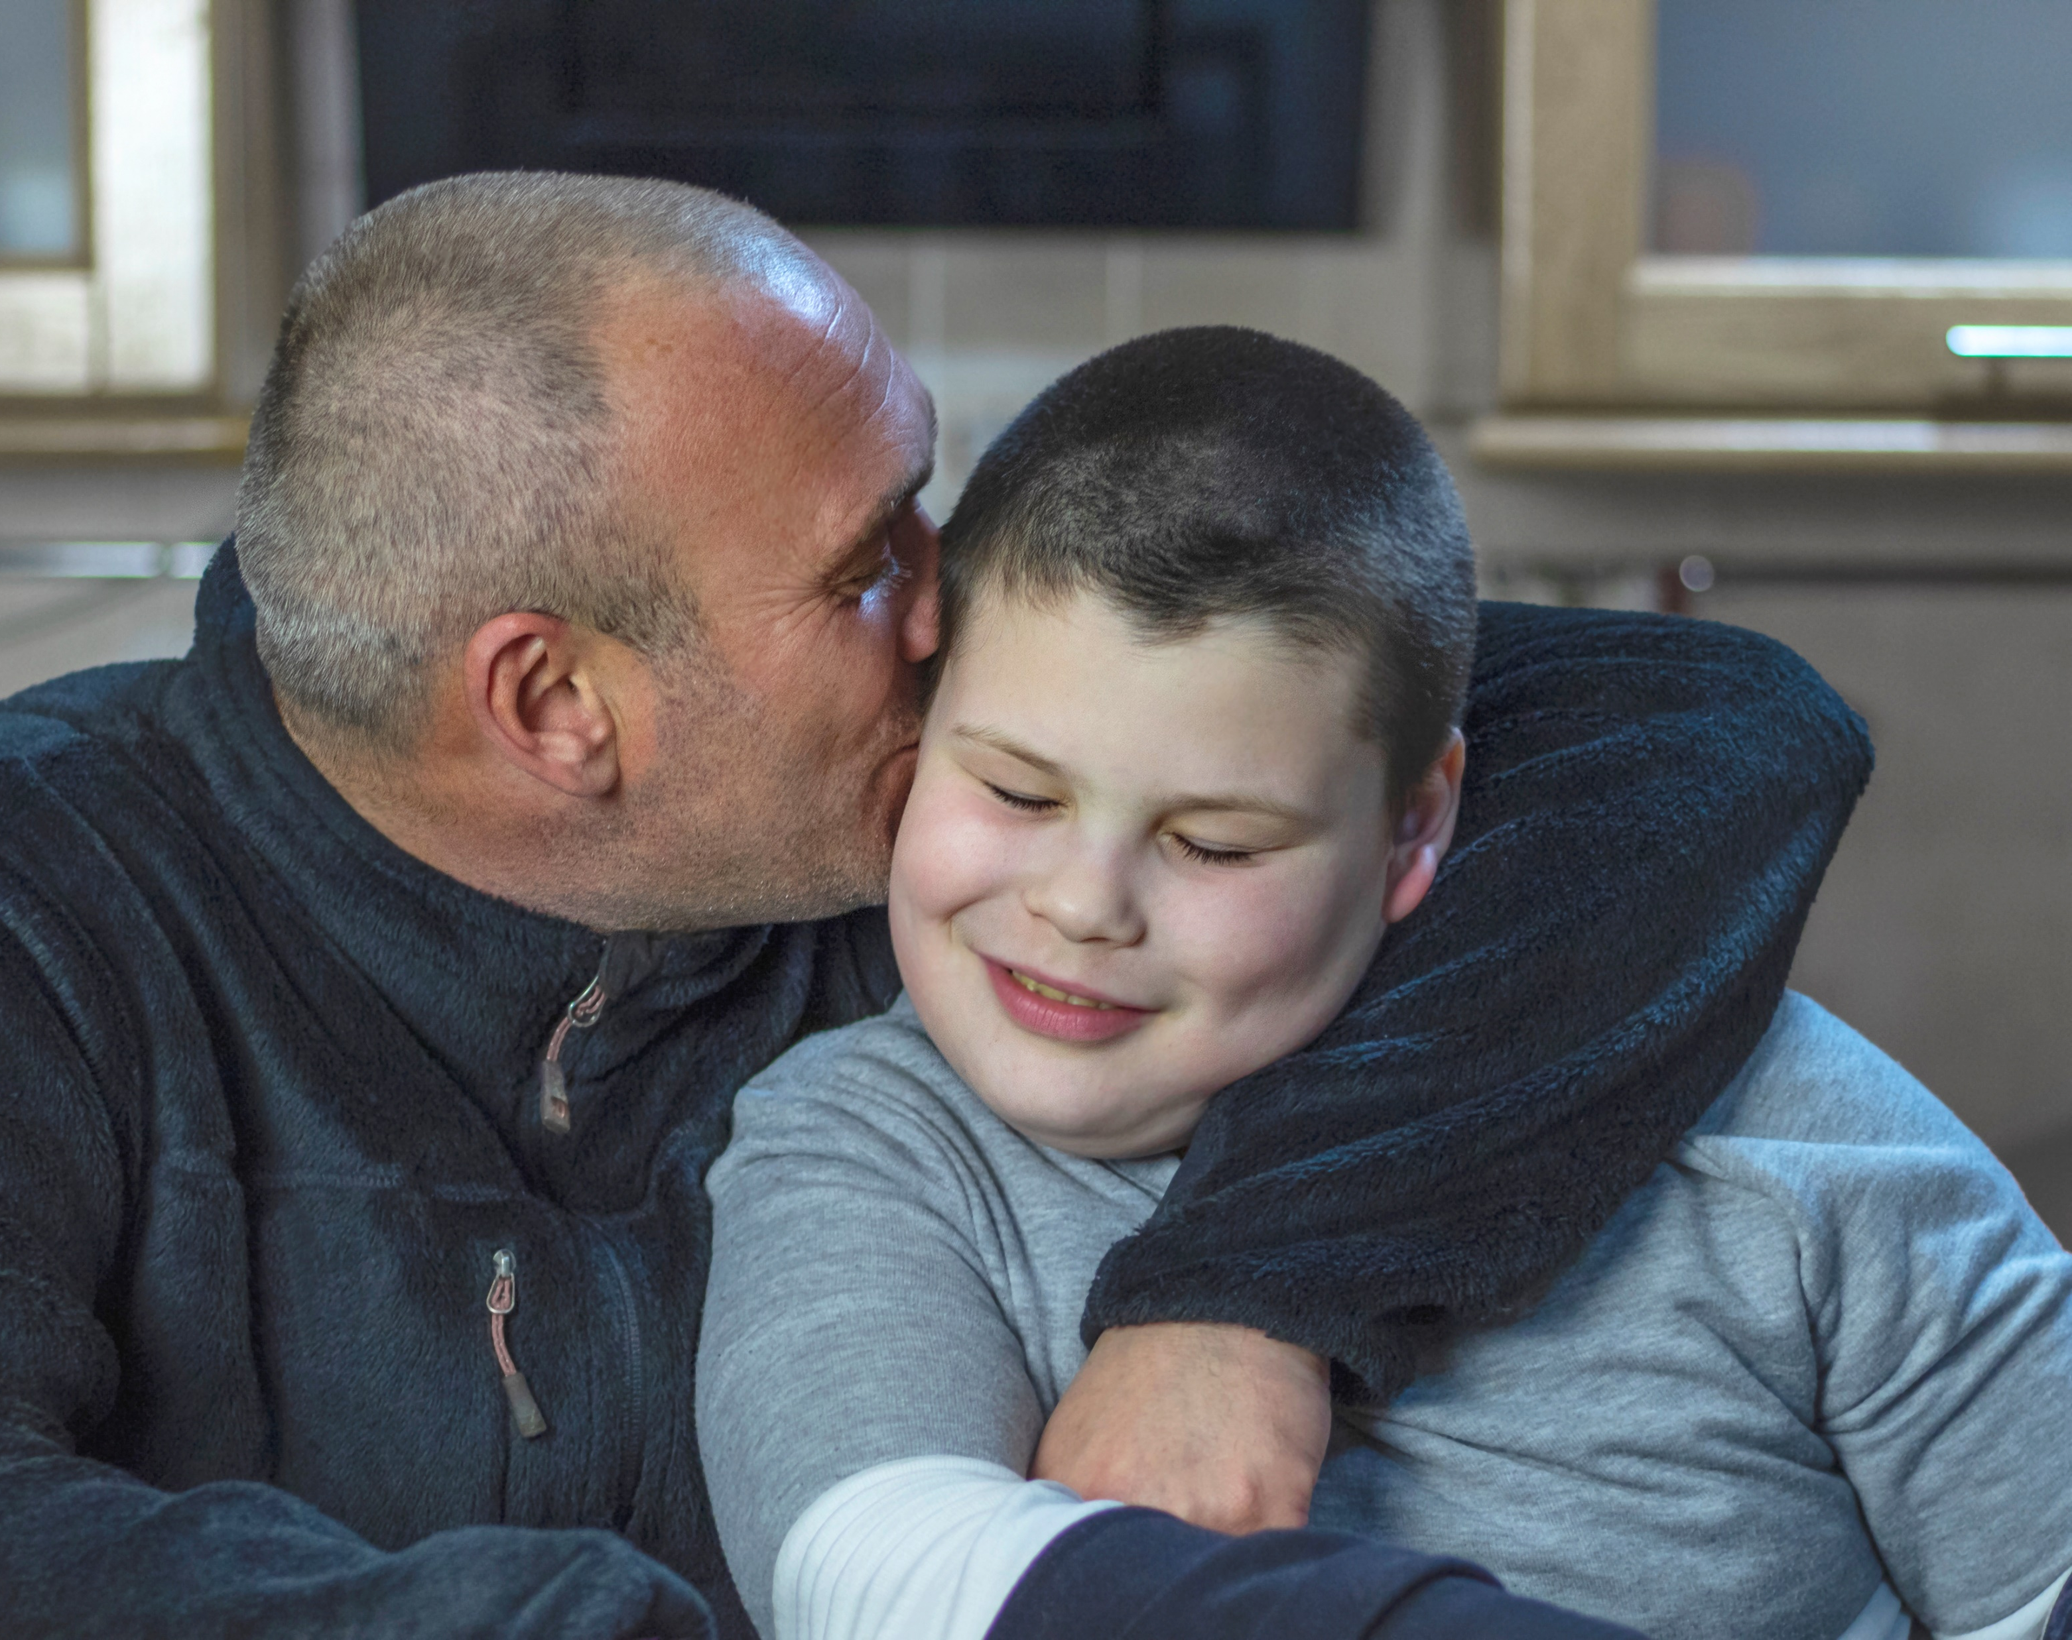
Some of the things we may be able to support with: • Mild to moderate difficulties with behaviour • Dysregulation – difficulties in recognising and managing emotions • Persistent feelings of anxiety stress and worry • Disengaging from school, general lack of interest • Difficulties in establishing and maintaining relationships with friends and/or family • Lack of interest in participating in activities • Formulation and guidance for professionals when experiencing feelings of uncertainty about how best to support or meet the needs of the child/children.
This Photo by Unknown Author is licensed under CC BY-NC-ND
Notes:
Tracy

Slide 5
SOME FAQ’S Are Bloom meetings confidential? What’s a nominated professional? Who can make a referral? What about the child/young person’s views? Who attends Bloom meetings? When do they take place?
Notes:
Ness/Tracy

Slide 6
MORE FAQ’S How quick is the process from referral to a Bloom meeting? Is there a waiting list? What happens after a Bloom meeting? What’s the formulation plan? Who receives a copy of the formulation plan? Can I re-refer?
Notes:
Ness/Tracy

Slide 7
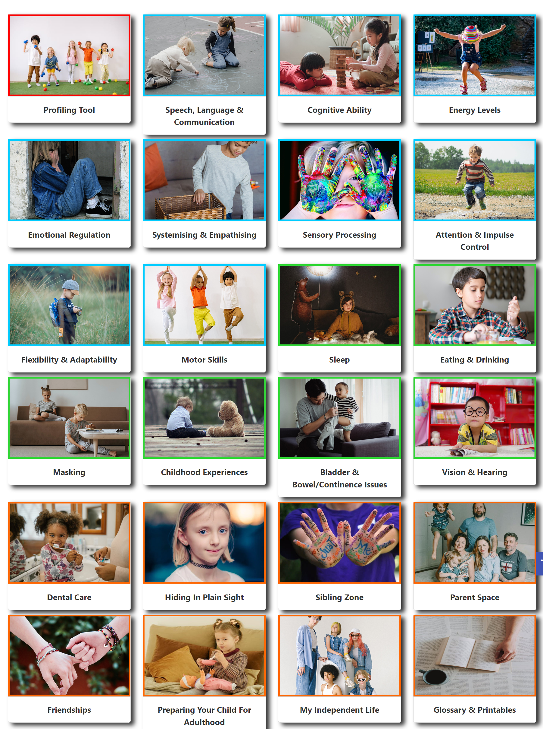
What is the Neurodiversity Pathway and how is this different to Bloom? - ND Profiling Tool - ND Consultations More information available: https://parentcarerscornwall.org.uk/neurodiversity (including how to access training in the ND Profiling tool)
Welcome to our Neurodiversity Hub which we hope you will find helpful. The Hub aligns to Cornwall & the Isles of Scilly Neurodevelopmental Profiling Tool, but it can be used by everyone. It forms a part of our early help offer of support for children, young people, and their families. The contributors to the content of the profiling sections are varied and include those with lived experience and professionals working with neurodivergent children and young people.
Notes:
Lisa
This Tool divides neurodevelopmental qualities into nine unique subsections.
These are:
1) Speech and Language 2) Energy Levels 3) Attention and Impulse Control 4) Emotional Regulation 5) Motor Skills 6) Sensory 7) Flexibility and Adaptability 8) Systemizing and Empathizing 9) Cognitive Ability

Slide 8
AN EXAMPLE REFERRAL Tim is 7 and lives with his mum, mum’s partner and 3 older siblings. Tim’s school is concerned about Tim’s reduced attendance at school following the death of his grandfather and his parent’s divorce earlier this year. When Tim is in school, he sometimes hits other children, and his anger can go from 0-60 in seconds. His peers are becoming wary of him, and he is no longer invited to birthday parties. Tim banged his hand into an external wall at school causing cuts and grazing and he became very distressed and asked to go home. Tim couldn’t explain why he’d done this. Mum says: “Tim upsets his brothers and sisters by teasing them and hiding their things.” Mum says she’s finding life difficult at the moment. She says her partner is supportive, but family relationships are becoming increasingly strained because of Tim’s behaviour. Mum and her partner alternate between feeling really sorry for Tim and wanting to help him, to punishing him by taking away his games and stopping him going to football, the one thing he loves.
Notes:
Tracy

Slide 9
POSSIBLE BLOOM OUTCOMES RELATING TO TIM - linking Tim with support in school (e.g. MHST, TIS/Thrive Practitioner) - consider bereavement support, e.g. Penhaligon’s Friends - signposting to resources for parents, e.g. Headstart, SPACE programme - identification of strengths & opportunities in the community/outside school & home, e.g. Cubs - written understanding (formulation) of what is going on for Tim - validation for professionals involved - identify possible support from Early Help, e.g. family worker
Notes:
Ness

Slide 10
SOME FEEDBACK ABOUT BLOOM ‘The depth of discussion and the support went beyond my expectations. Everyone was relaxed but professional; it made for an excellent environment for discussion and resulted in solid possible solutions for a complex situation. The child was very much at the centre of the discussions, but there was a very necessary holistic analysis of the situation. The range of professionals invited to the meeting was impressive.’ ‘As a school, we really appreciate the time and support of a group of very knowledgeable and skilled professionals. It is an extremely beneficial process’ ‘Lots of heads together with different ideas and perspectives.’
Notes:
Lisa – plus plug evaluation

Slide 11
To everyone who has been involved with and supported Bloom since its inception
Notes:
Ness/Tracy

Slide 12
Any Questions?

Slide 13
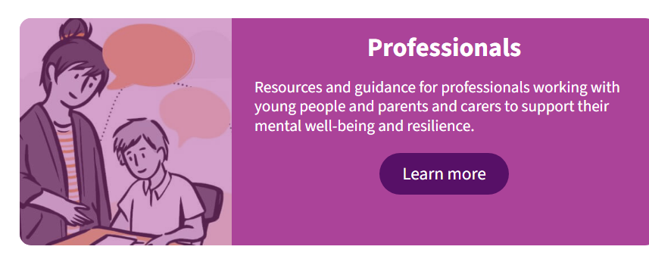
For more information on Bloom and to access resources click here BLOOM : Headstart Kernow
If you would like to get in touch with the team to discuss Bloom please e-mail us at
cft.camhsreferrals@nhs.net

